Slide 1
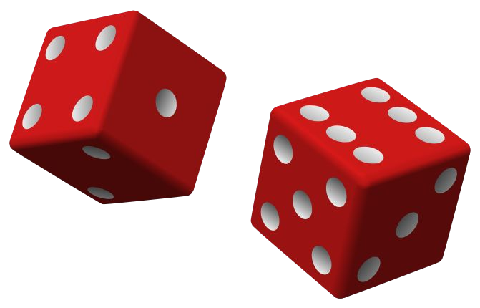
Naive Bayes

Slide 2
Naive Bayes - Introduction
Naive Bayes - (Sometime aka Stupid Bayes :) )
Classification technique based on Bayes’ Theorem
With “naive” assumption of independence among predictors.
Easy to build
Particularly useful for very large data sets
Known to outperform even highly sophisticated classification methods
a. e.g. Earlier method for spam detection

Slide 3
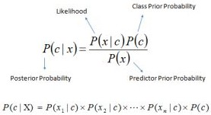
Introduction - Bayes theorem
P(c|x) - the posterior probability of class (c, target) given predictor (x, attributes).
P(c) - the prior probability of class.
P(x|c) - is the likelihood which is the probability of predictor given class.
P(x) - is the prior probability of predictor.

Slide 4
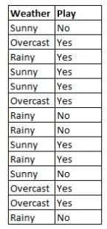
How Naive Bayes algorithm works
We are training data set of weather and corresponding target variable ‘Play’ (suggesting possibilities of playing).
Now, we need to classify whether players will play or not based on weather condition.

Slide 5
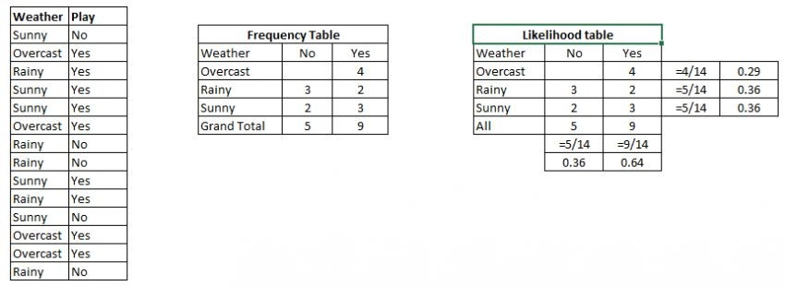
How Naive Bayes algorithm works
Convert the data set into a frequency table
Create Likelihood table by finding the probabilities like Overcast probability = 0.29 and probability of playing is 0.64.
Now, use Naive Bayesian equation to calculate the posterior probability for each class. The class with the highest posterior probability is the outcome of prediction.

Slide 6
How Naive Bayes algorithm works
Problem: Players will play if weather is sunny. Is this statement is correct?

Slide 7
How Naive Bayes algorithm works
Problem: Players will play if weather is sunny. Is this statement is correct?
P(Yes | Sunny) = P( Sunny | Yes) * P(Yes) / P (Sunny)

Slide 8
How Naive Bayes algorithm works
Problem: Players will play if weather is sunny. Is this statement is correct?
P(Yes | Sunny) = P( Sunny | Yes) * P(Yes) / P (Sunny) Here we have
P (Sunny |Yes) = 3/9 = 0.33, P(Sunny) = 5/14 = 0.36,
P( Yes)= 9/14 = 0.64

Slide 9
How Naive Bayes algorithm works
Problem: Players will play if weather is sunny. Is this statement is correct?
P(Yes | Sunny) = P( Sunny | Yes) * P(Yes) / P (Sunny) Here we have
P (Sunny |Yes) = 3/9 = 0.33, P(Sunny) = 5/14 = 0.36,
P( Yes)= 9/14 = 0.64
Now, P (Yes | Sunny) = 0.33 * 0.64 / 0.36 = 0.60, (high probability)

Slide 10
How Naive Bayes algorithm works
Problem: Players will play if weather is sunny. Is this statement is correct?
P(No | | | Sunny) | = | P( | Sunny | | No) | * P(No) | / | P | (Sunny)
Here | we | have
P (Sunny |No) = 2/5 = 0.4, P(Sunny) = 5/14 = 0.36,
P( No)= 5/14 = 0.36
Now, P (No | Sunny) = 0.4 * 0.36 / 0.36 = 0.40, (low probability)

Slide 11
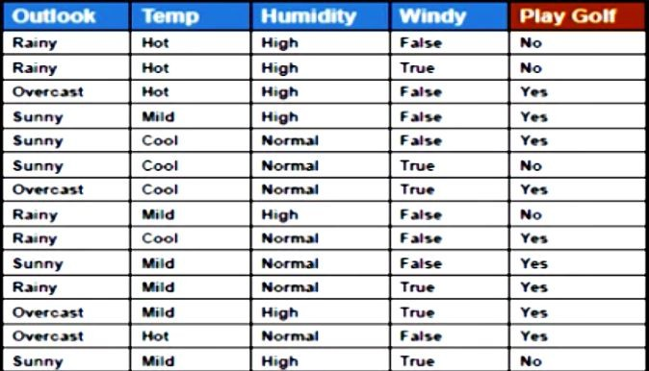
How Naive Bayes algorithm works
For Outlook = Rainy, Temp = Mild, Humidity = Normal, Windy = True, YES or No?
Problem2:
Rainy
Mild
Normal
True
???

Slide 12
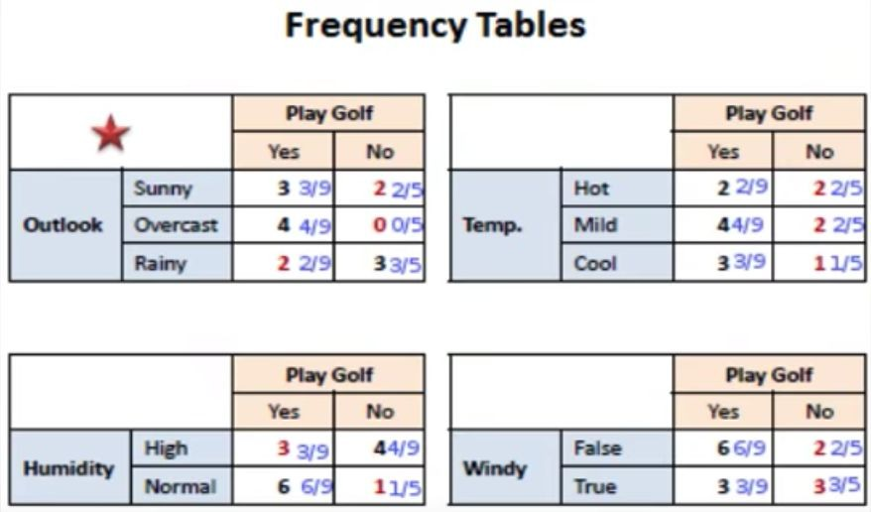
How Naive Bayes algorithm works
Lets prepare frequency tables of each feature

Slide 13
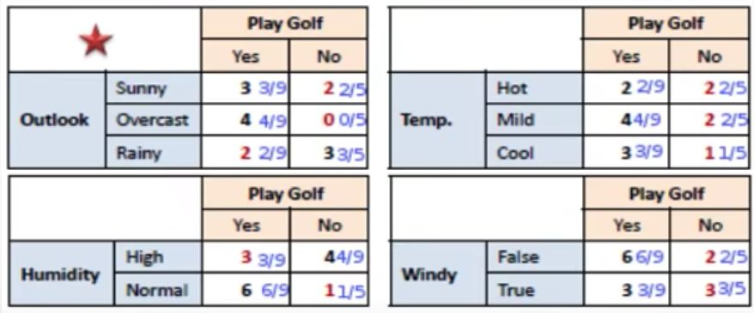
How Naive Bayes algorithm works
Problem2: For Outlook = Rainy, Temp = Mild, Humidity = Normal, Windy = True, YES or No?

Slide 14
How Naive Bayes algorithm works
Problem2: For Outlook = Rainy, Temp = Mild, Humidity = Normal, Windy = True, YES or No?
Likelihood of yes = P(Outlook = Rainy|Yes) * P(Temp = Mild| Yes) * P(Humidity = Normal|Yes)*P(Windy = True|Yes)*P(Yes)
= ?

Slide 15
How Naive Bayes algorithm works
Problem2: For Outlook = Rainy, Temp = Mild, Humidity = Normal, Windy = True, YES or No?
Likelihood of yes = P(Outlook = Rainy|Yes) * P(Temp = Mild| Yes) * P(Humidity = Normal|Yes)*P(Windy = True|Yes)*P(Yes)
= 2/9 * 4/9 * 6/9 * 3/9 * 9/14
= 0.0141

Slide 16
How Naive Bayes algorithm works
Problem2: For Outlook = Rainy, Temp = Mild, Humidity = Normal, Windy = True, YES or No?
Likelihood of yes = P(Outlook = Rainy|Yes) * P(Temp = Mild| Yes) * P(Humidity = Normal|Yes)*P(Windy = True|Yes)*P(Yes)
= 2/9 * 4/9 * 6/9 * 3/9 * 9/14
= 0.0141
Likelihood of No = P(Outlook = Rainy|No) * P(Temp = Mild| No) * P(Humidity = Normal|No)*P(Windy = True|No)*P(No)
= 3/5 * 2/5 * 1/5 * 3/5 * 5/14
= 0.0103

Slide 17
How Naive Bayes algorithm works
Problem2: For Outlook = Rainy, Temp = Mild, Humidity = Normal, Windy = True, YES or No?
Likelihood of yes = 0.0141
Likelihood of No = 0.0103
After Normalizaion,
Yes = 0.0141 / (0.0141 + 0.0103) = 0.58
No = 0.0103 / (0.0141 + 0.0103) = 0.42

Slide 18
How Naive Bayes algorithm works
Problem2: For Outlook = Rainy, Temp = Mild, Humidity = Normal, Windy = True, YES or No?
YES

Slide 19
Zero Frequency Problem
What if any of the count is 0?
?

Slide 20
Zero Frequency Problem
What if any of the count is 0?
Add 1 to all counts
It is a form of Laplace smoothing
See https://en.wikipedia.org/wiki/Additive_smoothing

Slide 21
Using Python
#Import Library of Gaussian Naive Bayes model from sklearn.naive_bayes import GaussianNB import numpy as np
#assigning predictor and target variables
X= np.array([[-3,7],[1,5], [1,2], [-2,0], [2,3], [-4,0], [-1,1], [1,1], [-2,2], [2,7], [-4,1],
[-2,7]])
y = np.array([3, 3, 3, 3, 4, 3, 3, 4, 3, 4, 4, 4])
#Create a Gaussian Classifier model = GaussianNB()
# Train the model using the training sets model.fit(X, y)
#Predict Output
predicted= model.predict([[1,2],[3,4]]) print(predicted)
See the Jupyter Notebook.

Slide 22
Tips to improve the Naive Bayes Model
If continuous features do not have normal distribution,
we should use transformation or different methods to convert
If test data set has zero frequency issue,
apply smoothing techniques “Laplace smoothing”
Remove correlated features,
as the highly correlated features are voted twice in the model
and it can lead to over inflating importance.
Naive Bayes classifier has limited options for parameter tuning
Can’t be ensembled - because there is no variance to reduce

Slide 23
Variants
Gaussian:
It is used in classification and it assumes that features follow a normal distribution.
Multinomial:
It is used for discrete counts.
Implements the naive Bayes algorithm for multinomially distributed data It is one of the two classic naive Bayes variants used in text classification
Bernoulli:
The binomial model is useful if your feature vectors are binary (i.e. zeros and ones).
One application would be text classification with ‘bag of words’ model where the 1s & 0s are “word occurs in the document”
and “word does not occur in the document” respectively.
http://scikit-learn.org/stable/modules/naive_bayes.html

Slide 24
Applications
Real time Prediction:
Naive Bayes is an eager learning classifier and it is sure fast. Thus, it could be used for making predictions in real time.
Multi class Prediction:
Well known for multi class prediction feature.

Slide 25
Applications
Text classification/ Spam Filtering/ Sentiment Analysis:
Mostly used in text classification
Have higher success rate as compared to other algorithms.
Widely used in Spam filtering (identify spam e-mail)
and Sentiment Analysis
Recommendation System:
Naive Bayes Classifier and Collaborative Filtering together builds a Recommendation System that uses machine learning and data mining techniques to filter unseen information and predict whether a user would like a given resource or not

Slide 26
Further references
http://scikit-learn.org/stable/modules/naive_bayes.html
https://en.wikipedia.org/wiki/Bayes%27_theorem
https://en.wikipedia.org/wiki/Naive_Bayes_classifier

Slide 27
Naive Bayes
Thank you!

